Slide 1

COVID-19 PANDEMIC IN SOUTH AFRICA DEMOGRAPHY VOLUME 2020
Presentation to SG
December 2020

Slide 2

To project the full impact of COVID-19 without sufficient trend data will create an uncertain set of population estimates for current planning and decision making.
Fertility
Mortality
Migration
The impact of
COVID-19 on conception and subsequent fertility will only be reflected in the reported births of 2021.
There were 2 657 reported COVID-related deaths by mid-year 2020, which is marginal in comparison to overall death counts in a given year. It is premature to speculate on the annual COVID-19 related deaths for the 2020 MYPE cycle.
There is a reduction in international migration, which is indicative of COVID-19 travel restrictions. Internal mobility in this period has mostly been temporary whilst the MYPE requires a more permanent act of migration.

Slide 3
The relationship between pandemic and fertility: Some assumptions of COVID-19 and fertility in South Africa

Slide 4
On average, a woman will give birth to 2,33 children in her lifetime*
The total fertility rate peaked in 2008 at 2,66 and is declining, reaching 2,33
in 2020.
Total Fertility Rate, 2002–2020
* Provided that current fertility behaviour prevails
Mid Year Population Estimates 2020

Slide 5
According to the Centers for Disease Control and Prevention (CDC) the top five causes of death, except for tuberculosis, are the comorbidities that result in Covid-19 fatalities.
Underlying causes of death among females: Mortality and causes of death in South Africa
Mortality and Causes of Death, 2017

Slide 6
All age groups were affected by NCDs, however women aged 40–44 and 45–49 years had the highest proportion of non-communicable diseases (NCDs) over a three year period.
Non-communicable diseases (NCDs) among women 15–49
Source: Mortality and causes of death in South Africa: Findings from death notification, 2017. The unknown age and ill-defined diseases have been redistributed proportionately to causes of death.

Slide 7
Infection rate was highest among the female population aged 45-49 (2014) per 100 000 population.
COVID-19 infection rates for (15–49 years) per 100 000 population by sex
Source: Patterns of COVID-19 infections, deaths and admission by age and sex according to NICD 2020

Slide 8

FERTILITY STUDY CONCLUSIONS
COVID-19 may not impact the fertility rates in the country because the age-sex structure of COVID-19 data in S.A. indicates that the rate of infections, admissions and deaths is highest among the elderly women
1
Age pattern of COVID-19 infection, admission and deaths may possibly result in demographic outcomes such as fertility postponement or change in fertility intentions
2
The pressures from the COVID-19 response on strained health services in low- and middle-income countries may have disrupted sexual reproductive health in various ways
3

Slide 9

Mortality
(Deaths)

Slide 10
Deaths peaked in 2006, thereafter decreasing to the current value of 515 804 in 2020.
Total number of deaths estimated over time vs AIDS-related deaths, 2002–2020
695 461
515 804
All Deaths
AIDS- Related Deaths
Source: Mid-Year Population Estimates 2020

Slide 11
By age group, cumulative COVID-19 deaths from 5 March-21 November 2020 were high amongst persons aged 60–69 (27,2%), followed by persons aged 50–59 (21,5%). Adherence to public health measures by the elderly may also account for the lower proportion of COVID-19 mortality.
Percentage distribution of COVID-19 deaths by age and sex
Source: Covid-19 sentinel hospital surveillance update, South Africa week 47 2020 - National Institute for communicable diseases

Slide 12
The highest percentage of cumulative COVID-19 deaths from 5 March-21 November 2020 were recorded in Gauteng (25,0%), followed by Eastern Cape (22,4%).
Percentage distribution of COVID-19 deaths by province
Source: Covid-19 sentinel hospital surveillance update, South Africa week 47 2020 - National Institute for communicable diseases

Slide 13
High blood pressure is the most common chronic condition reported among women and men aged 15+ (23% and 13%, respectively).
Percentage distribution of women and men aged 15+ with self-reported chronic conditions
Source: SADHS, 2016

Slide 14
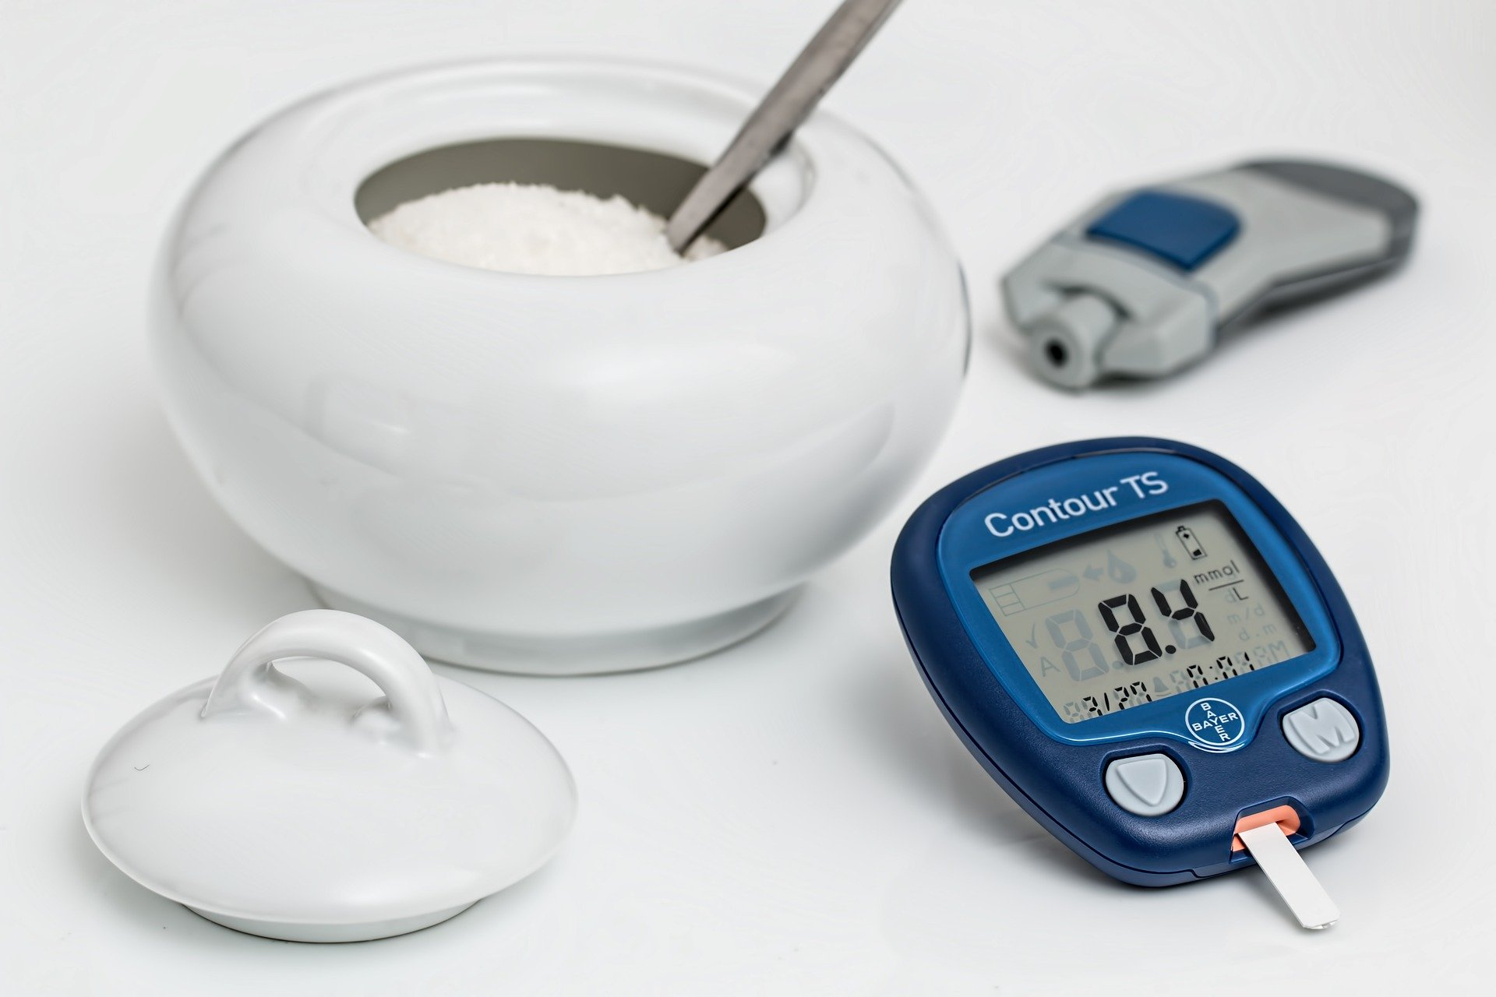
Diabetes mellitus was the leading cause of death for those aged 65 and older (9,0%).
Leading underlying natural causes of death by age
Age groups | Leading underlying natural causes of death
Infants (Age 0) | Respiratory and cardiovascular disorders specific to the perinatal period, responsible for 16,2% deaths at this age.
1–14 | Influenza and pneumonia, responsible for 7,1% deaths, followed by intestinal infectious diseases with 6,2% deaths in this age group.
15–44 and 45–64 | Tuberculosis was the leading underlying natural cause of death, constituting 11,3% and 7,9% of deaths, respectively.
65 and older | Diabetes mellitus was the leading cause of death for those aged 65 and older (9,0%).
Source: Mortality and causes of death in South Africa: Findings from death notification, 2017. The unknown age and ill-defined diseases have been redistributed proportionately to causes of death.

Slide 15
COVID-19 AND MORTALITY IN SA:
CONCLUSIONS
Results suggest that COVID-19 mortality data are in line with existing literature which show that mortality risks are higher in men compared to females.
1
Vital registration data also indicate that the proportion of deaths due to communicable diseases (TB, HIV, chronic lower respiratory diseases) were higher amongst males, while deaths due to non-communicable diseases (hypertension, diabetes, cardiovascular diseases, obesity) were higher amongst females.
2
Findings from this report shows that age-sex disaggregated data as well as an understanding of the country’s mortality and morbidity patterns are important during the COVID-19 pandemic
3

Slide 16

MIGRANTS IN THE INFORMAL SECTOR IN SOUTH AFRICA, FINDINGS FROM THE QUARTERLY LABOUR FORCE SURVEY, 2017

Slide 17
For the period 2016–2021 GP will receive 3 times more migrants than the WC
Estimated provincial migration streams, 2016–2021
Net Migration from Outside SA
Net Migration Within SA
Source: Mid-year Population, 2020

Slide 18
Labour market status by place of birth, 2017
Discouraged
work seekers
Employed
Unemployed
Other NEA
1,2M Employed
73K Discouraged
0,38M Other NEA
0,3M Unemployed
Source: Labour Dynamics 2017

Slide 19
Migrants, whilst having a higher level of employment than non-migrants, work predominantly in the informal sector in South Africa (more than half).
Distribution of the population by migration status and by labour market status, ages 15–64, QLFS Q3: 2017
More than half of migrants of working age in South Africa, work in an unprotected job sector, with little to no safety nets.

Slide 20
The majority of migrants in the 15–44 year age group work in the informal sector, 70% in the age group 15–24.
Distribution of the population by migration status and by labour market status, ages 15–64, QLFS Q3: 2017
Notes:
More male than female migrants work in the informal sector, and the majority of migrants in the 15-44 year age group, work in the informal sector. To note, seventy per cent of migrants in the early youth category (15-24) work in the informal sector.
The majority of migrants in Free State, Eastern Cape and KwaZulu-Natal, NW, MP and LP, work in the informal sector. The majority of migrants in a non-metro area, work in the informal sector.

Slide 21
More than 40% of migrants work in a job that has no employment contract and has an unspecified duration
Distribution of the population by migration status and by labour market status, ages 15–64, QLFS Q3: 2017
Notes:
If the principal of “no work, no pay,” is to be applied, the majority of migrants do not work for employers who contribute to UIF, meaning that these migrant employees will most likely be left immediately with no wage or salary.
Job stability and security is an integral aspect as it is essential for an individual to plan their financial situation. However, more than 40%of migrants work in a job which does not have an employment contract and has an unspecified duration, meaning that the job can end at any time.

Slide 22

MIGRANTS IN THE INFORMAL SECTOR: CONCLUSIONS
The informal economy is an unprotected sector with little to no safety nets. COVID-19 presented particular challenges to those working in this sector
1
A higher proportion of migrants than non-migrants are employed, however the type of employment and stability of employment differ.
2

Slide 23
Thank you

